Slide 1



PEILab Group Meeting
Leader: Zicong Hong
Team Member: Jian Lin, Haodong Wang, Qianli Liu, Kaibin Guo, Junjie Liu

Slide 2
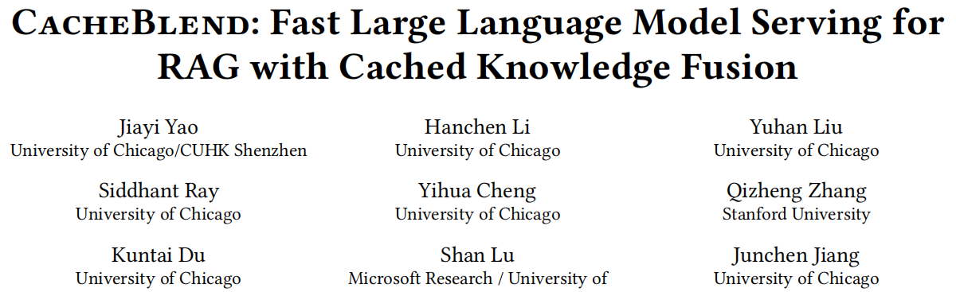
CacheBlend
Eurosys’25

Slide 3
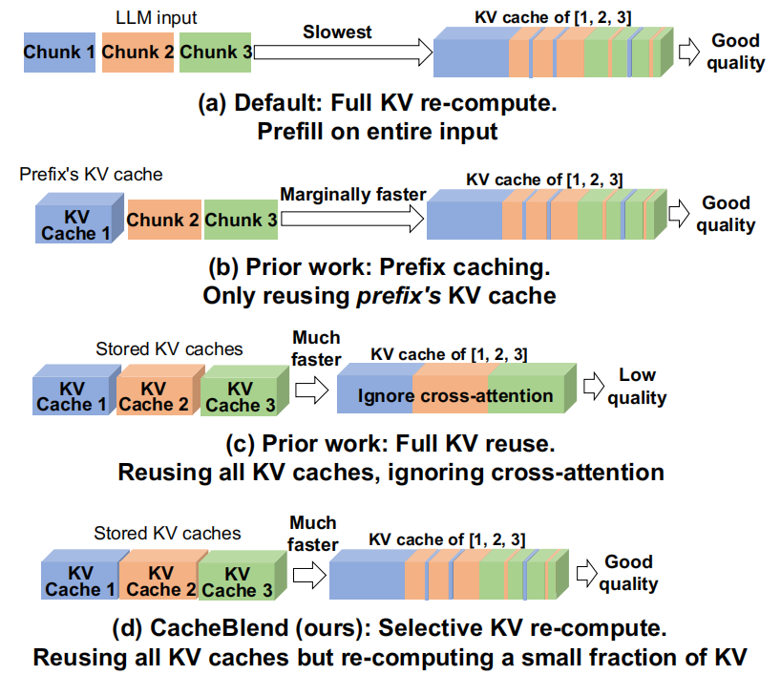
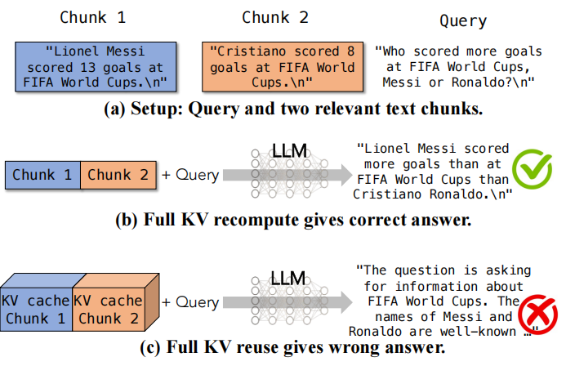
CacheBlend
Motivation
Reusing Full KV, ignoring corss-attention

Slide 4
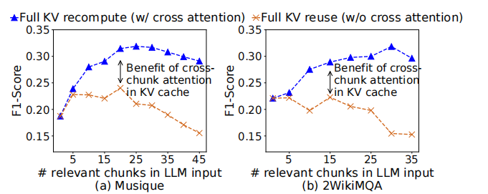
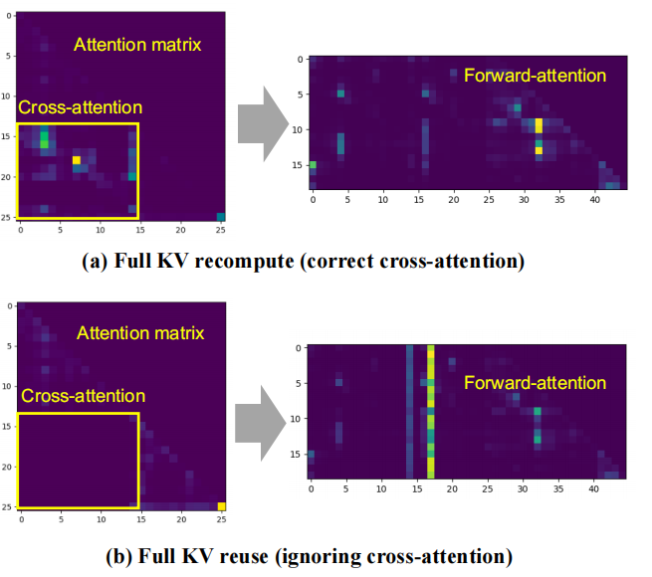
CacheBlend
Reusing Full KV, ignoring corss-attention

Slide 5
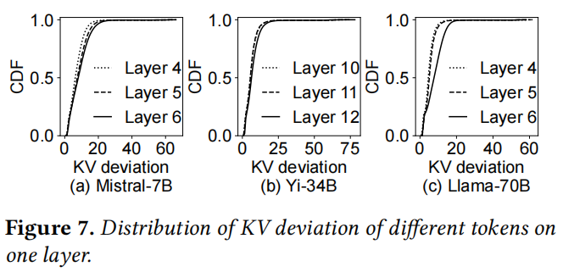
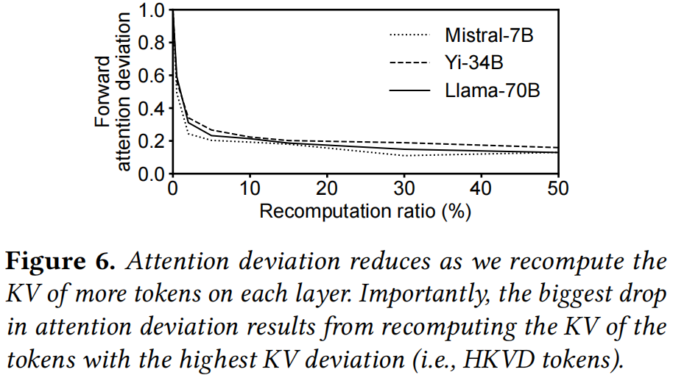
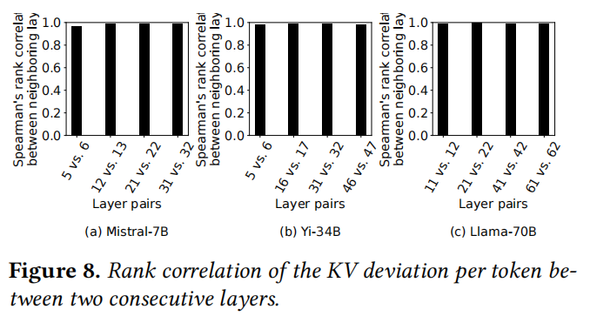
CacheBlend

Slide 6
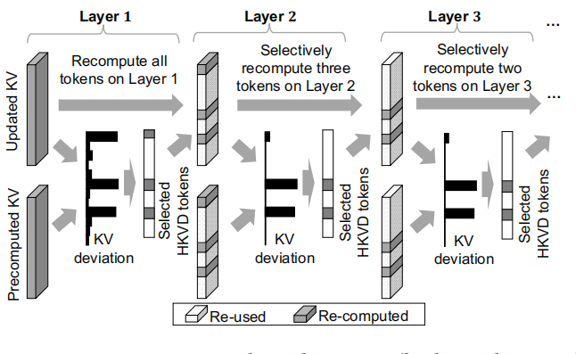
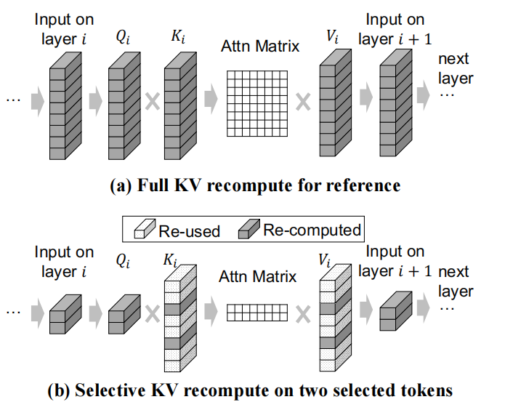
CacheBlend
Selecting which tokens to recompute
Selectively recomputing KV cache

Slide 7
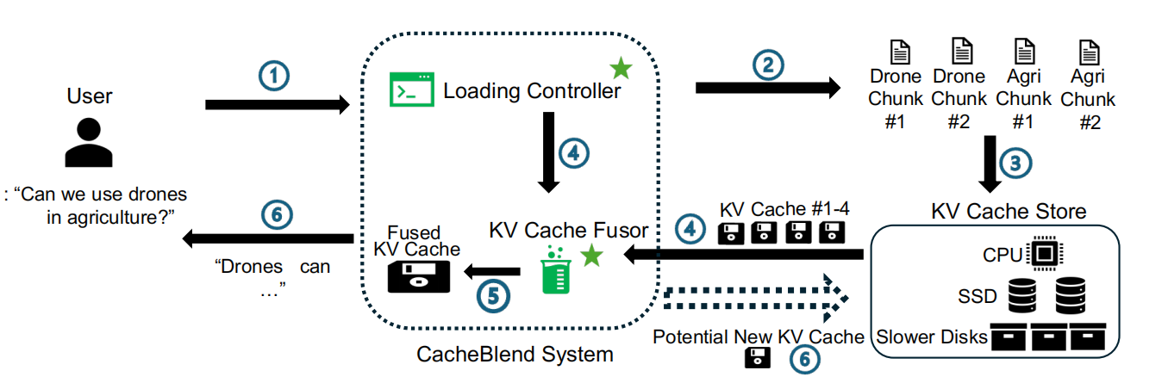
CacheBlend
CacheBlend system

Slide 8
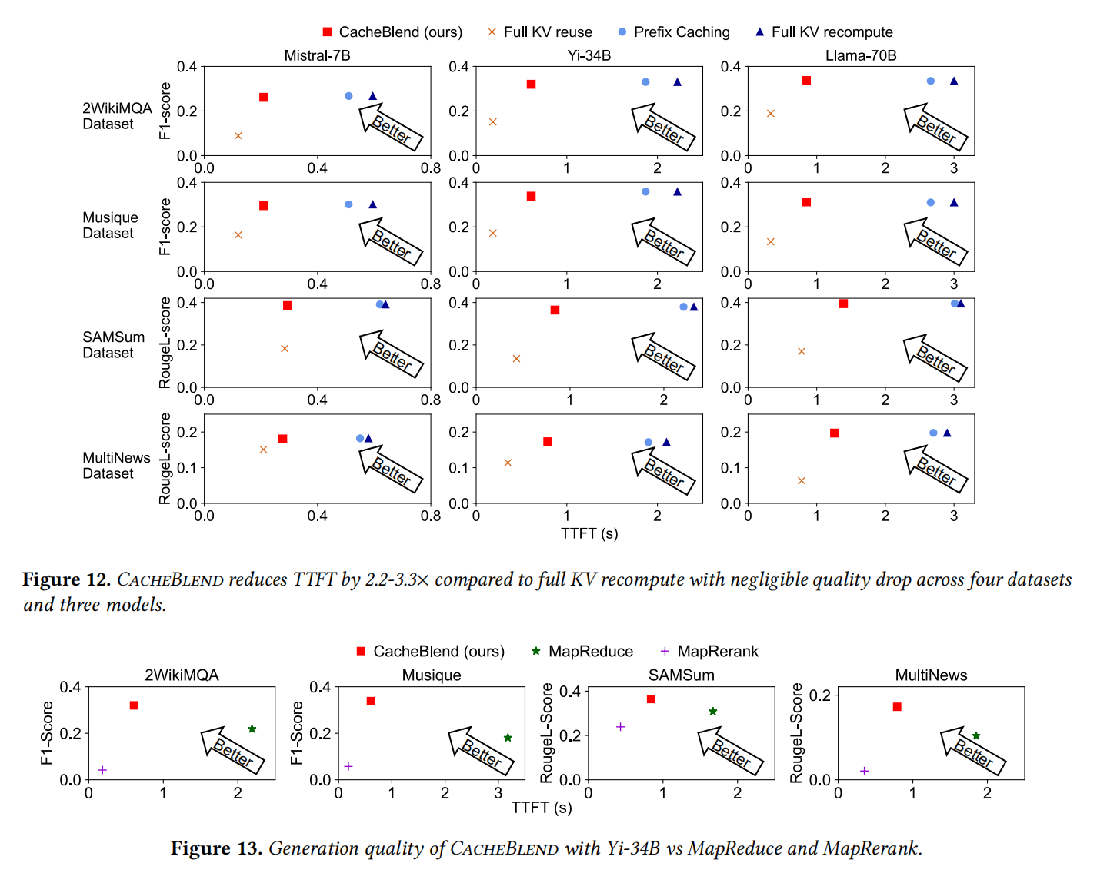
CacheBlend
Result

